Slide 1
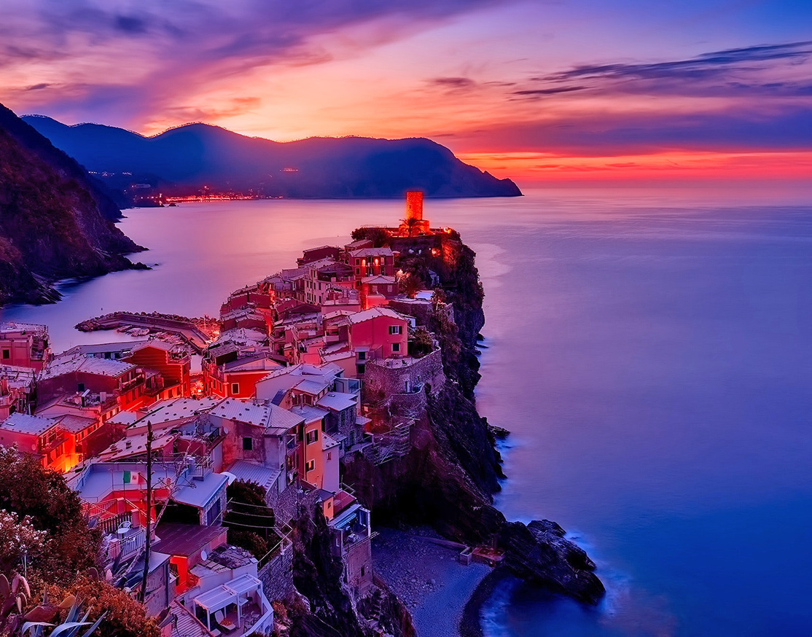
Pandora New Store Launch Event
A New Beginning in Miami
11 Oct 2024, Brickell City Centre
Notes:
Slide 1: Introduction
Greetings to one and all for joining us for this session on the Pandora New Store Launch Event. We would like to announce the details on this occasion as well. The event is planned for 11 Oct 2024 at our new store in Miami. This launch is not a mere opening but a golden chance to reach out to our valuable customers and say cheers for the latest chapter we start today for Pandora in this city. This activity and promotion plan has been designed to ensure that this event is not only fun but fun in a way that will not cause frustration to the target end-users. Let's go through the details.

Slide 2
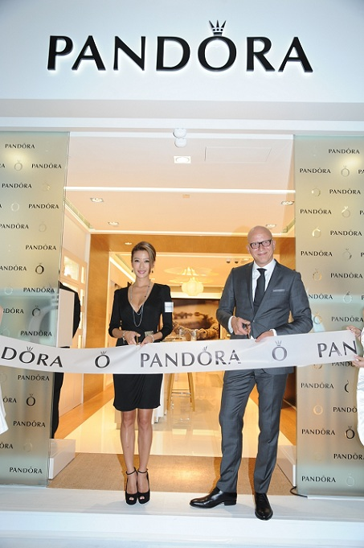
Event Overview
Event Type: Weekend Event (3 days)
Theme: Product Promotion and Community Engagement
Objective: Introduce New Collection and Strengthen Local Presence
Key Message: “Discover the New Pandora Experience”
Notes:
Slide 2: Event Overview
This event will last for only three days, from Friday through Sunday. The central theme of the channels incorporates product promotion and community building together. We would also like to present our new collection and, at the same time, interact with the community (Xintong, 2022). Promoting the new concept, “Discover the New Pandora Experience,” would be our prominent tagline used by all marketing collaterals. This event will help to display lovely jewelry and to underline our company’s responsibility to the people.

Slide 3
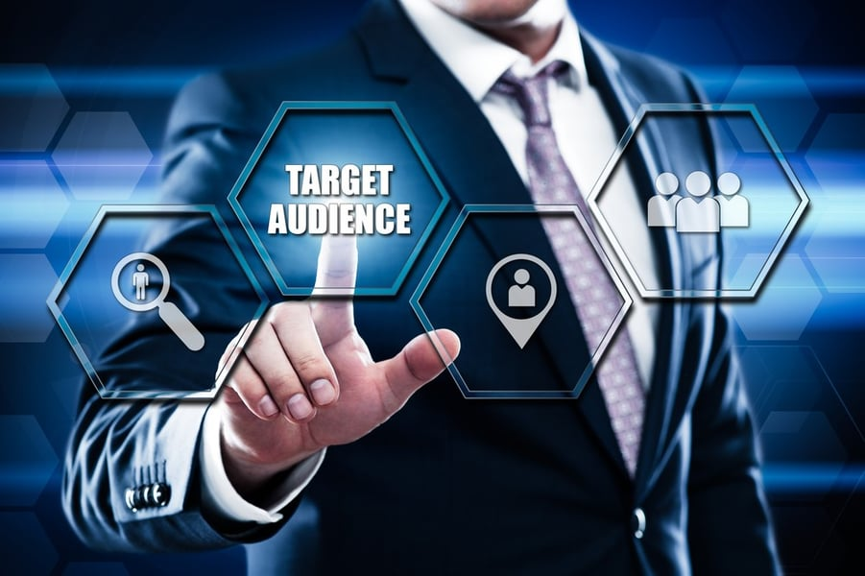
Target Audience
Primary Audience: Women aged 18-45, fashion-forward, and style-conscious.
Secondary Audience: Gift buyers, families, and tourists.
Geographic Focus: Residents of Miami, and nearby areas.
Psychographic Profile: Interested in luxury fashion and self-expression.
Notes:
Slide 3: Target Audience
The target consumer group is individuals from 18 to 45 years of age, specifically women who have a passion for fashion and style. They will probably ask themselves about Pandora jewelry's quality and design. We are also aiming at those in search of gifts, family, and tourists who might do their shopping in that store during the weekend. This is mainly because our targeted population comprises residents in Miami and the adjacent regions. These individuals appreciate beauty and use jewelry articles to reflect their personality and even to portray their societal status.

Slide 4
Event Activities
Day 1: VIP Preview Night
Exclusive look at the new collection, with refreshments.
Day 2: Product Demonstrations
Live demos by Pandora stylists.
Day 3: Family Day
Fun activities for families, discounts, and giveaways.
Special Offers:
Limited-time discounts on selected items.
Notes:
Slide 4: Event Activities
Our different target groups will be reached through the following activities to be conducted each day of the event. The first day’s event will be the VIP Preview Night, during which guests can view the new collection and take a cup of coffee/tea. The second day will be dedicated to clarifying why our jewelry is so beautiful and how one piece can be worn in several ways; Pandora stylists will demonstrate this (Rosário & Raimundo, 2021). The last day, determined based on the target audience, is Family Day, with product promotion based on family-related activities such as discounts and gifts. All these activities are meant to leave a positive image on everyone attending your event.

Slide 5

Promotional Strategies
Social Media Campaigns: Targeted ads on Instagram, Facebook, and TikTok.
Email Marketing: Personalized invitations to loyal customers.
Influencer Collaborations: Partnering with local influencers.
Traditional Media: Local radio, newspapers, and flyers.
Notes:
Slide 5: Promotional Strategies
Therefore, We have developed the right promotional plans to ensure that the event reaches out to many people. As a significant element, social media campaigns will involve the preparation of commercials to be posted on social sites such as Instagram, Facebook, and TikTok that target the intended audience. We will also have to use email marketing to extend an invitation to some of our most loyal customers. Also, we are initiating communication with local famous individuals to promote the event in society. In the meantime, we have employed print media, including local radio/ newspaper, and fliers to reach an even larger audience. Combining these kinds of media will allow us to address our target groups constructively.

Slide 6
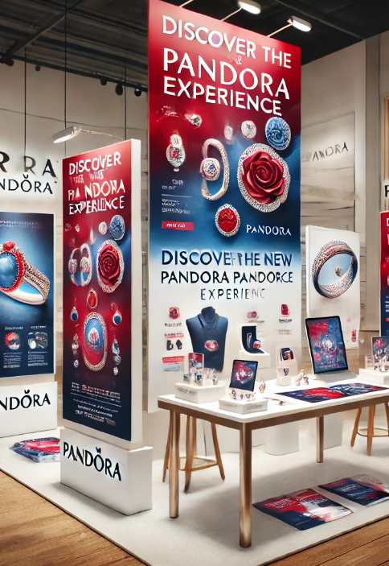
Marketing Communication Integration
Consistent Theme: “Discover the New Pandora Experience” across all platforms.
Visual Consistency: Unified design elements in all promotional materials.
Digital Integration: Website updates, social media posts, and email campaigns.
In-Store Branding: Banners, posters, and displays reflecting the theme.
Notes:
Slide 6: Marketing Communication Integration
To enhance the delivery of this message, we have articulated a consistent marketing communication plan. The slogan “Discover the New Pandora Experience” will apply to all the advertisement releases we publish. Based on the proposed campaign, we have developed visual products that are present in both online and traditional advertisements (Infante & Mardikaningsih, 2022). Website, social media posts, and emails, among others, are examples of the visual aspect of the branding we will implement. Amidst the store, there will be banners, posters, and display stands that conform to the same theme. This will assist in reinforcing the message of our branding and integrating it into a consistent image for the customer.

Slide 7
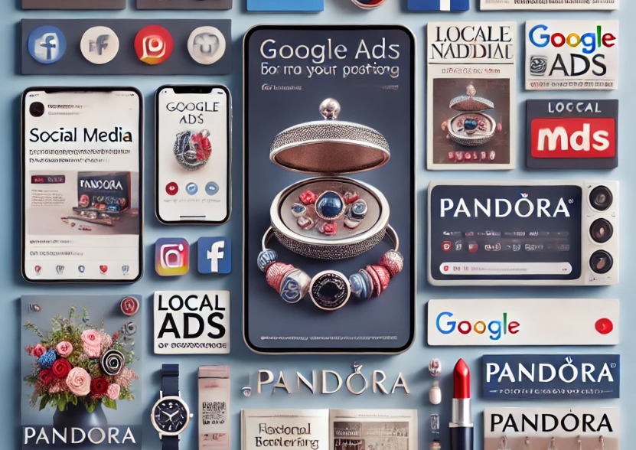
Media Choices
Digital Media: Social media ads, Google Ads, Pandora's website.
Traditional Media: Local newspapers, lifestyle magazines, radio spots.
Event Media: In-store posters, signage, and interactive screens.
Collaborations: Partnerships with local boutiques and fashion blogs.
Notes:
Slide 7: Media Choices
To popularise the event, we employ conventional and electronic communication methods. The digital plan comprises social advertisements on Facebook and Instagram, Google Ads, and constant content updates on the Pandora online platform. We are adverts in local newspapers, lifestyle magazines, and radio for tradition and on media. In the store, we will use posters and signs and go the extra step to provide interactive touch screens. We also work with local shops and fashion bloggers to get the word out about the brand (Santiago & Castelo, 2020). These above-mentioned media options will help the organization communicate with a broad range of clients.

Slide 8
Budget Overview
Total Budget: $50,000
Breakdown:
Promotions: $20,000
Event Setup: $15,000
Influencer Fees: $5,000
Miscellaneous: $10,000
Contingency Fund: 10% of total budget.
Notes:
Slide 8: Budget Overview
This includes our total budget, which is $50,000 for the event. Of this total, almost $20,000 will be used for promotion to ensure that consumers hear about the event. The arrangements for the event should cost roughly $15,000 in terms of decorations, catering, and other similar necessities. There is $5,000 set aside for influencer marketing to increase our presence online. There is also a miscellaneous amount of $ 10,000 when expenditures do not fall into the main categories. For such situations, we have budgeted 10% of the total cost as the contingency budget should something unexpected occur.

Slide 9
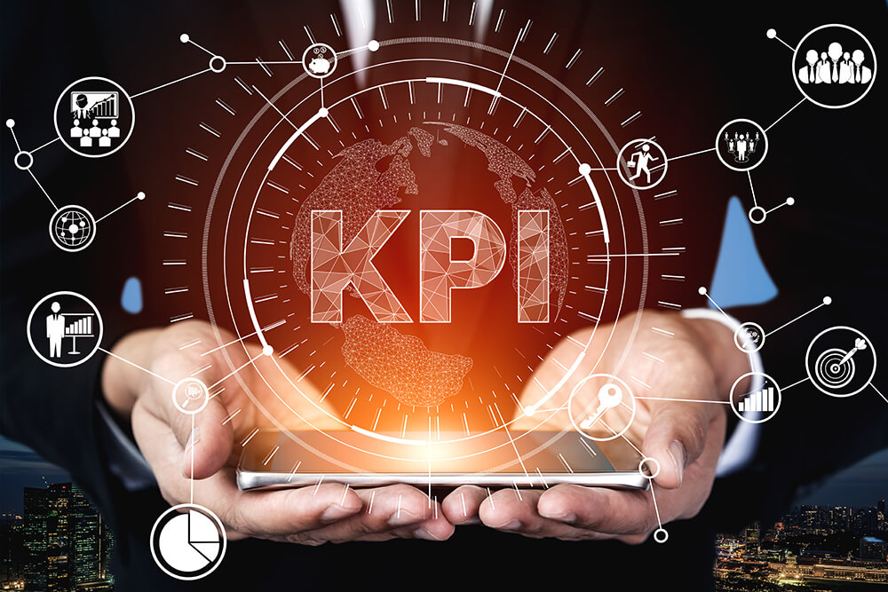
Event Success and Evaluation
KPIs:
Foot Traffic: Goal of 1,000 visitors over the weekend.
Sales: Target sales of $30,000 during the event.
Social Media: 5,000 new followers, 20,000 impressions.
Customer Feedback: Achieve 80% satisfaction rate.
Tools:
Surveys, sales reports, social media analytics.
Notes:
Slide 9: Event Success and Evaluation
Three main criteria have been established to assess the degree of success of our event. We will need at least 1,000 visitors over the weekend and product sales of $30,000 to accomplish our goals. For social media, the targeted followers are 5000, and the impressions targeted are 20000. We shall also gather customer feedback and seek to achieve 80% customer satisfaction. It will be conducted using questionnaires, sales figures, and social media data to measure our performance. These metrics will allow us to assess the event's outcome and make corresponding improvements to organize similar events further.

Slide 10



Event Success and Evaluation
Tools
Sales reports
Social media analytics
Surveys
Notes:
Slide : 10 Event Success and Evaluation
The research will be conducted using questionnaires, sales figures, and social media data to measure our performance. These metrics will allow us to assess the event's outcome and make corresponding improvements to organize similar events further.

Slide 11
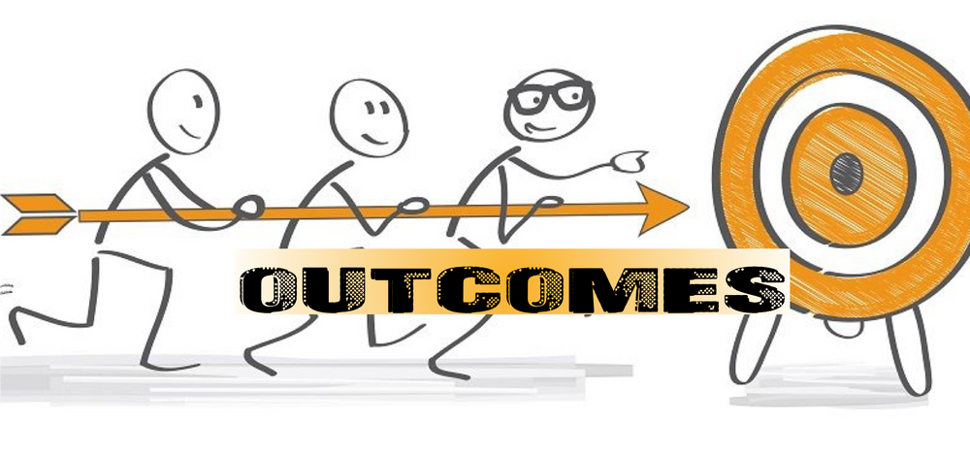
Conclusion
Summary: The event is a key opportunity to boost brand visibility and community engagement.
Expected Outcomes: Increased sales, enhanced brand loyalty, and positive community feedback.
Notes:
Slide 11: Conclusion
Last but not least, the present store launch event is ceremonial for Pandora in Miami. It gives a platform to enhance brand identity and engage with the community. It is suggested that sales will rise, brand recognition will likely improve, and feedback on the events from the attendees will be positive. During the latter part of the event, we will also summarize and evaluate the event's effectiveness and get in touch with our customers to sustain the event’s upbeat atmosphere. I appreciate your attention, so I would love to listen to questions or even just comments.

Slide 12
References
Infante, A., & Mardikaningsih, R. (2022). The Potential of social media as a Means of Online Business Promotion. Journal of Social Science Studies (JOS3), 2(2), 45-49.
Rosário, A., & Raimundo, R. (2021). Consumer marketing strategy and E-commerce in the last decade: a literature review. Journal of theoretical and applied electronic commerce research, 16(7), 3003-3024.
Santiago, J. K., & Castelo, I. M. (2020). Digital influencers: An exploratory study of influencer marketing campaign process on instagram. Online Journal of Applied Knowledge Management (OJAKM), 8(2), 31-52.
Xintong, H. U. (2022, March). Case Study of Pandora, a Light Luxury Jewellery Brand. In 2022 7th International Conference on Financial Innovation and Economic Development (ICFIED 2022) (pp. 1818-1822). Atlantis Press.
Notes:
References
Infante, A., & Mardikaningsih, R. (2022). The Potential of social media as a Means of Online Business Promotion. Journal of Social Science Studies (JOS3), 2(2), 45-49.
Rosário, A., & Raimundo, R. (2021). Consumer marketing strategy and E-commerce in the last decade: a literature review. Journal of theoretical and applied electronic commerce research, 16(7), 3003-3024.
Xintong, H. U. (2022, March). Case Study of Pandora, a Light Luxury Jewellery Brand. In 2022 7th International Conference on Financial Innovation and Economic Development (ICFIED 2022) (pp. 1818-1822). Atlantis Press.

Slide 13
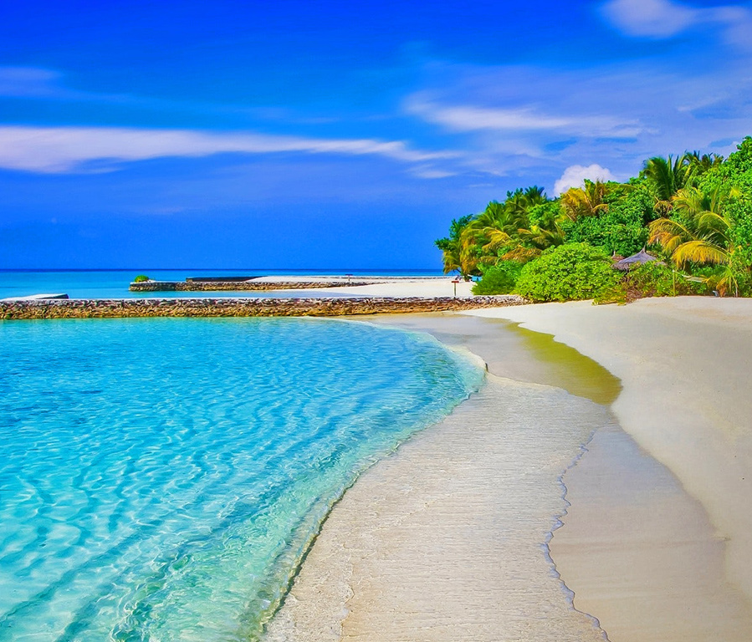
THANK YOU!

